Slide 1
LEARNERA
Team Name: LEARNERA
Team Members:
AVANTIKA – 2210990197
AVIREET KAUR-2210990202
CHARVI BANSAL-2210990236

Slide 2
INDEX
Objective
Introduction
Methodology, Approach & Techniques
Algorithm
Result
Source Code (screenshots)
Conclusion
Reference

Slide 3

OBJECTIVE
Our objective is to leverage the power of ReactJS, HTML, and CSS to craft an immersive educational website.
Our platform is designed to empower students by providing them with a dynamic learning environment where they can engage with educational content .
Through our innovative approach, we aim to inspire and facilitate active learning, fostering academic growth

Slide 4

INTRODUCTION
LEARNERA
“Empowering Minds, Shaping Futures”
Welcome to “Learnera”, a transformative educational platform dedicated to empowering learners worldwide.
Today , we invite you to embark on a journey through the dynamic realm of “Learnera” where knowledge knows no bound and learning is a lifelong adventure
Join us on showcasing how React technology has transformed the landscape of “LEARNERA”.

Slide 5

METHODOLOGY, APPROACH & TECHNIQUE
METHODOLOGY
APPROACH
TECHNIQUES
Firstly develop a content plan which includes the outlining of subjects, topics , and resources we’ll offer on the website.
Then conduct the market research for analysing the existing educational websites , identifying gaps , and determine unique selling points.
Break down the project into smaller tasks or user stories , prioritize them based on their importance, and deliver incremental updates to the website.
Create a user-centric design that place the needs and preferences of the users at the forefront of the design process.
Conduct user research , gather feedback, and iterate on designs to create an intuitive and engaging user experience.
Collaborative development that is regular communication and teamwork between team members that can lead to better outcomes and faster problem solving.
React.js:"Learnera" harnesses the power of React.js, a JavaScript library for building user interfaces, to create a dynamic and interactive educational platform.
HTML & CSS: The foundation of "Learnera" is built upon HTML and CSS, the core technologies of the web
Canva: Graphics and visual elements play a crucial role in enhancing the user experience of "Learnera."

Slide 6

ALGORITHM
Routing Algorithm:
Uses the React Router library for client-side routing, allowing navigation between different components/pages within the single-page application
Carousel Navigation Algorithm:Manages the navigation functionality for a carousel component.
Frontend Routing Algorithm: Involves mapping URLs to specific views or components in a single-page application
Form Submission Algorithm: Used for storing the information submitted by user
Styling and Layout Algorithms: Uses CSS for making the website visually appealing.

Slide 7
ALGORITHM
State Management Algorithm :
The Carousel component utilizes the useState hook from React to manage the state of the active slide index
Focus and Blur Event Handling:
Utilizes event handling techniques to add or remove focus styles from input fields based on user interactions.
Image Selection Algorithm: Allows users to select and display different images based on button clicks
Data Fetching Algorithm:
Simulates fetching data from an API or external source in a React component
Dropdown Toggle Algorithm:
This algorithm controls the visibility of dropdown content in a FAQ component.

Slide 8
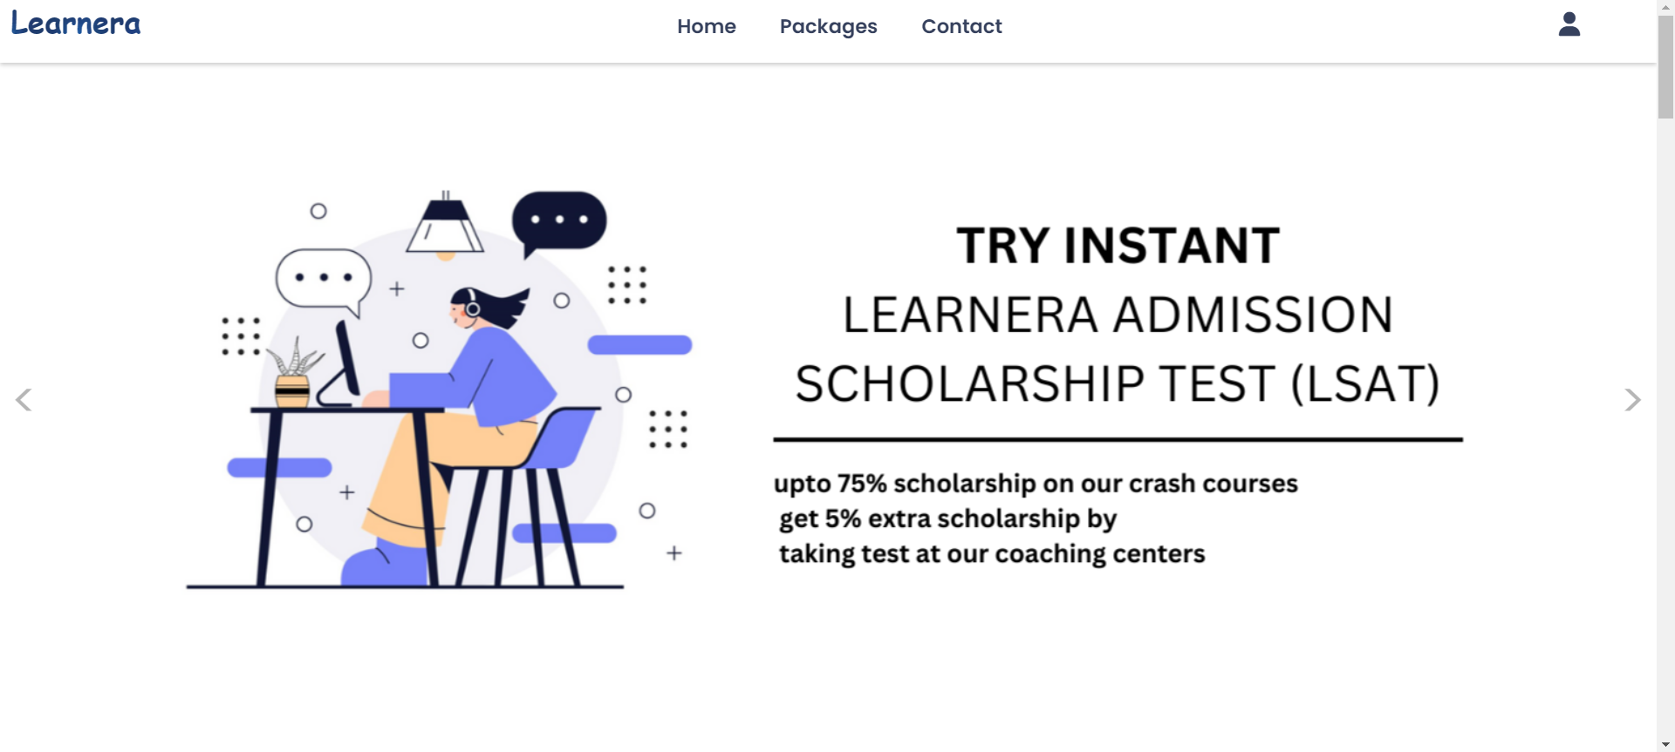
SCREENSHOTS

Slide 9
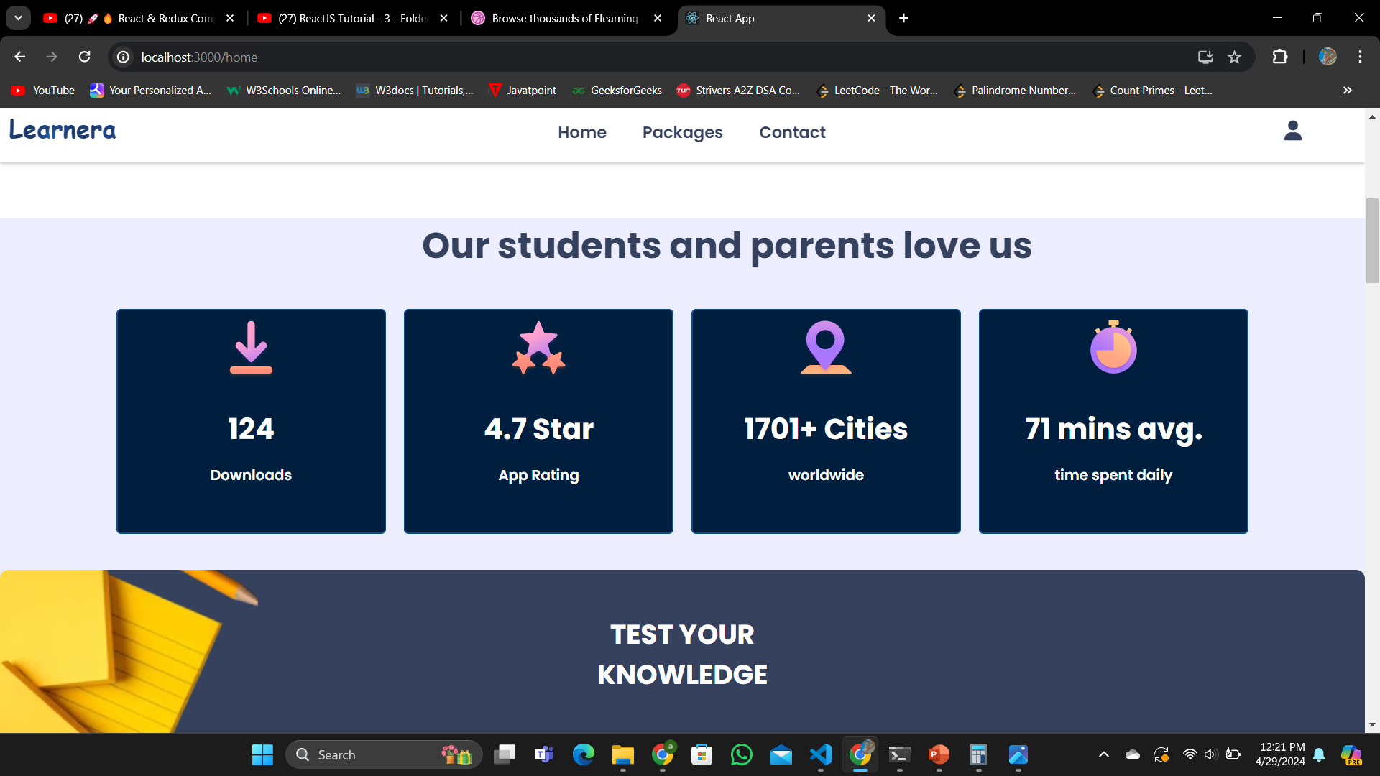
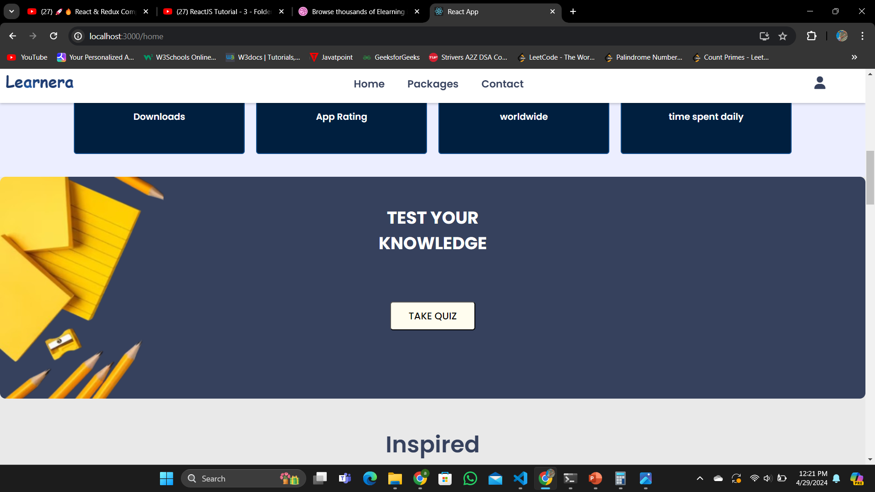

Slide 10
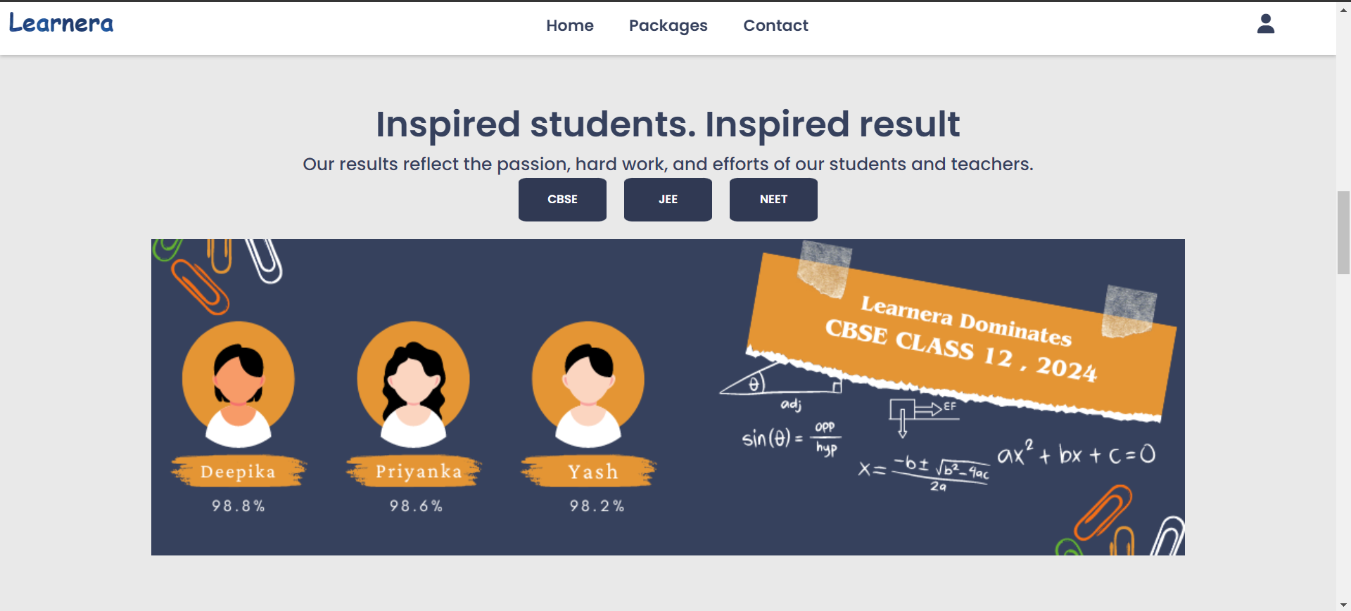

Slide 11
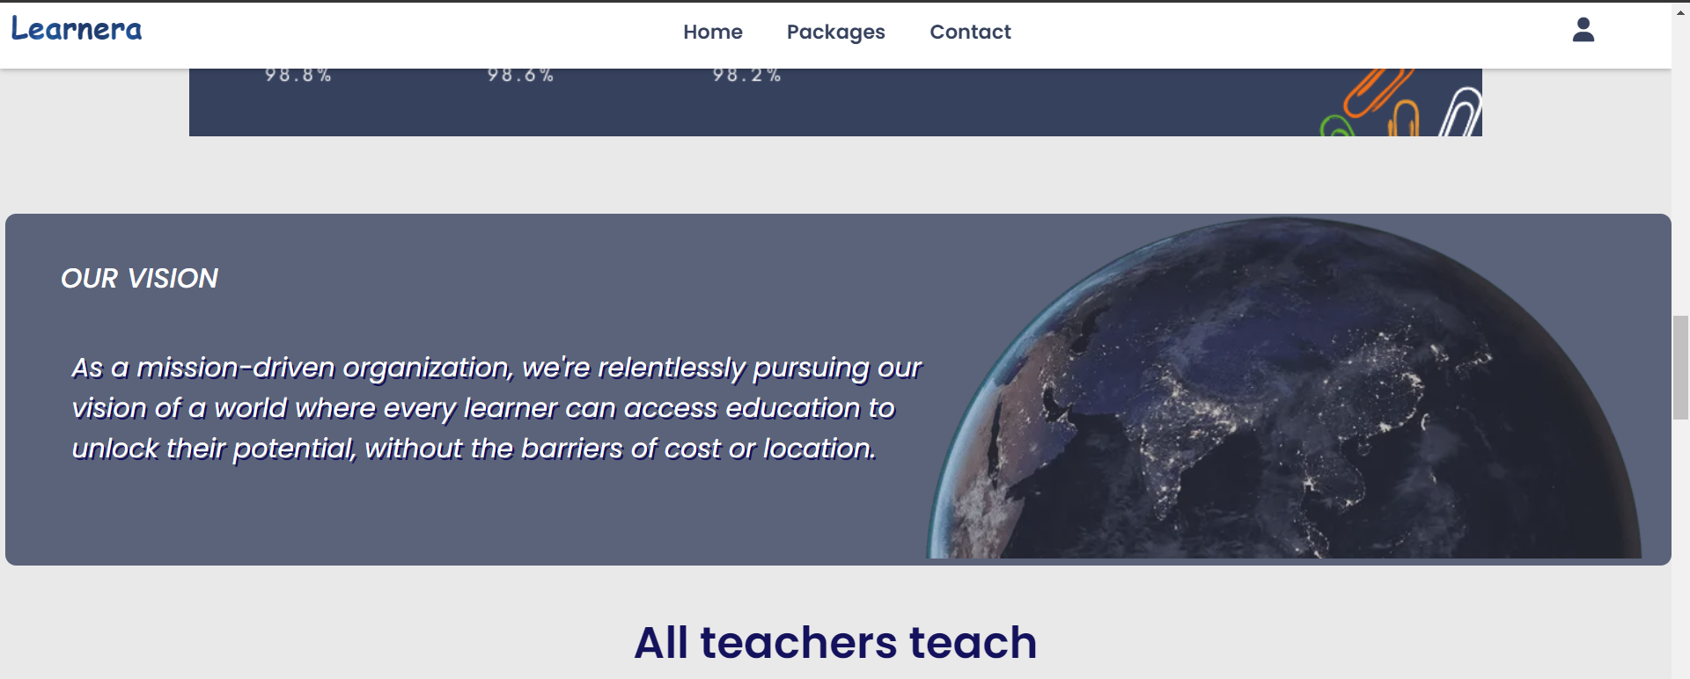

Slide 12
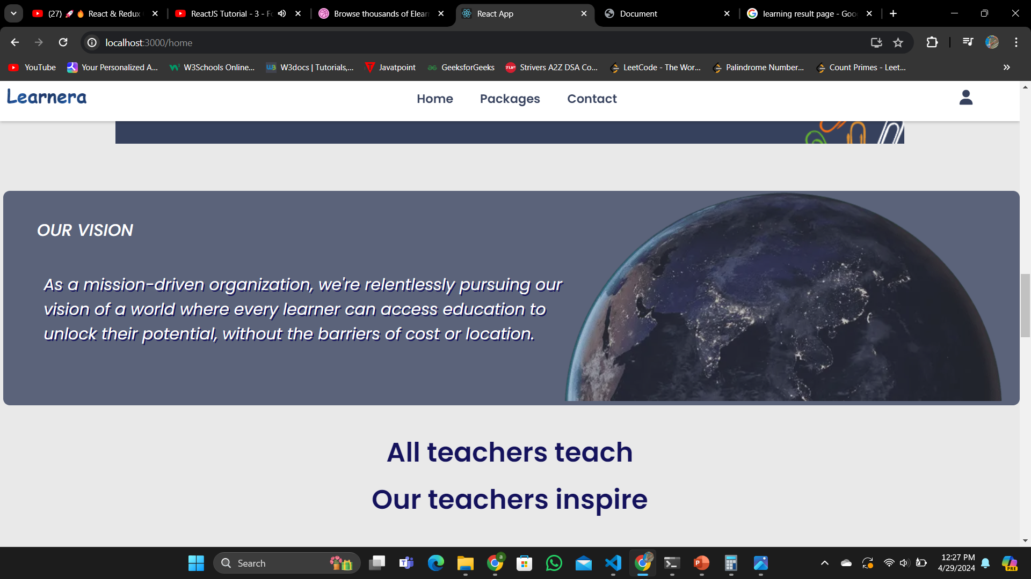
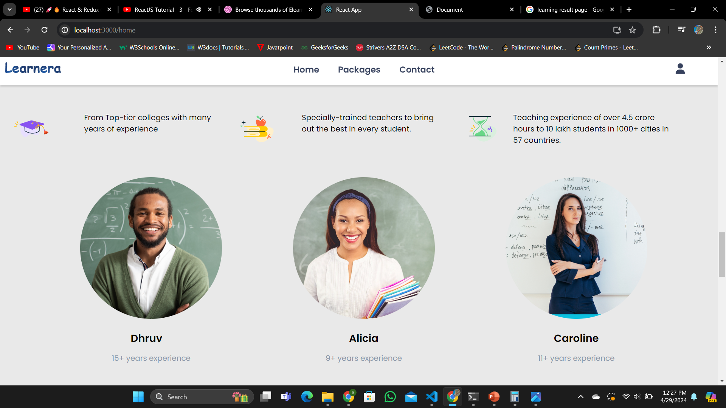

Slide 13
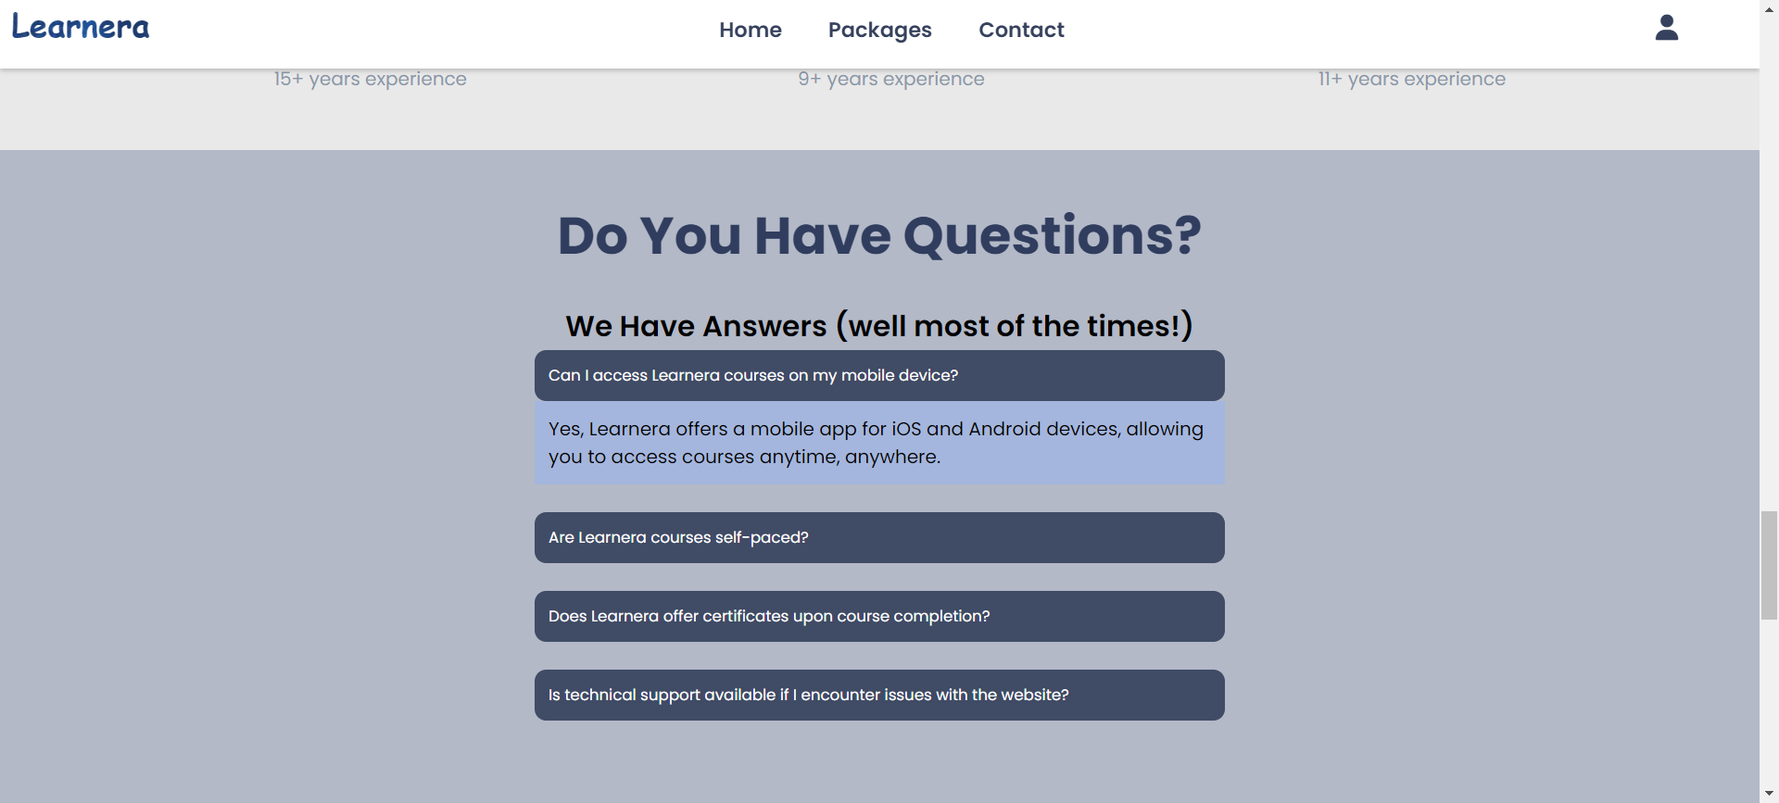

Slide 14
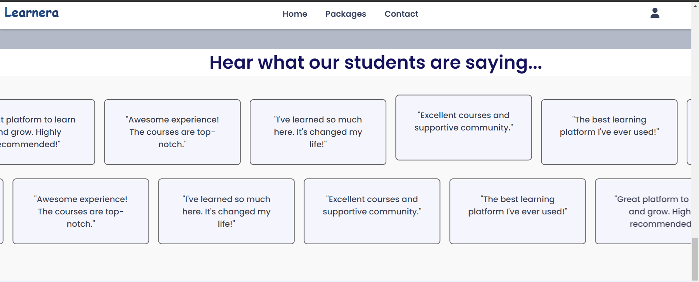

Slide 15
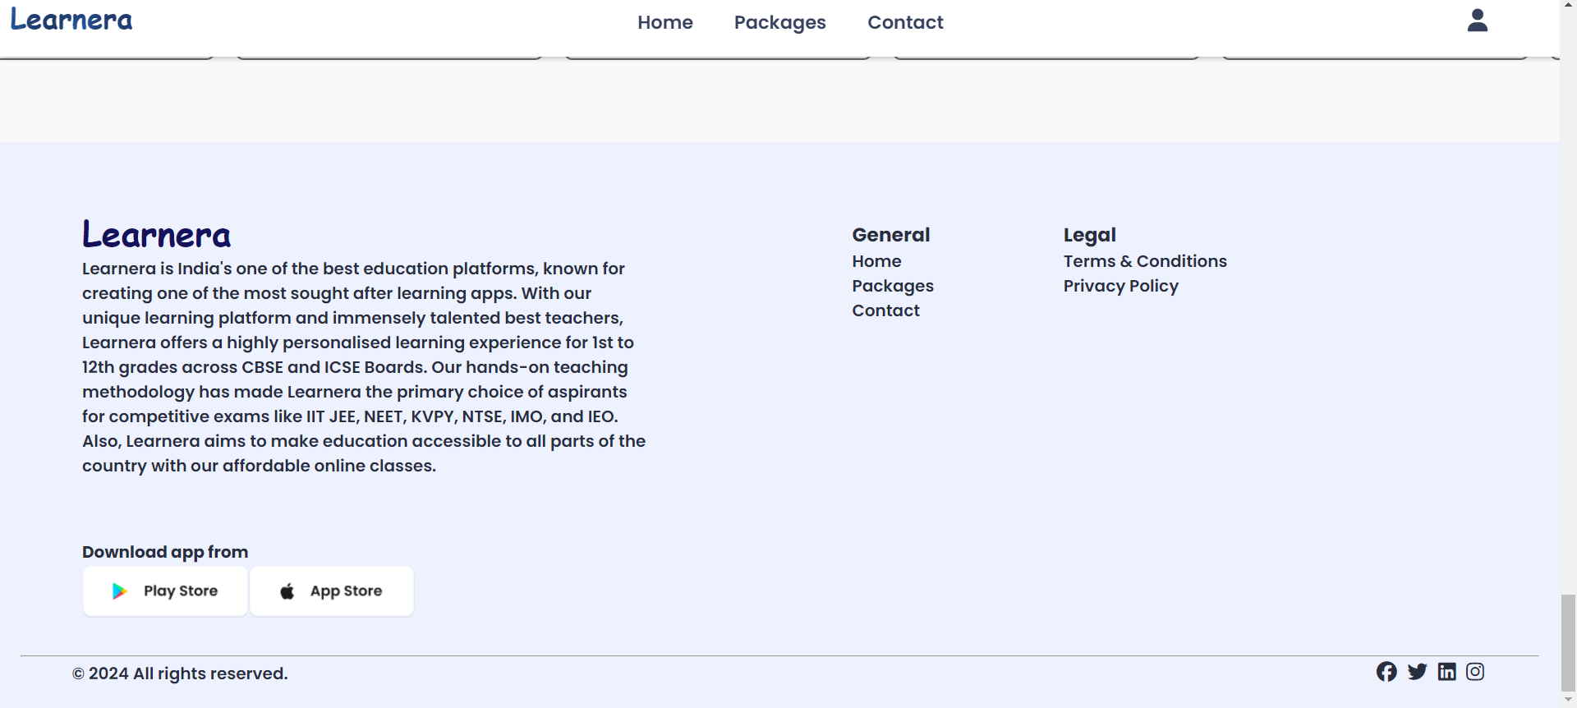

Slide 16
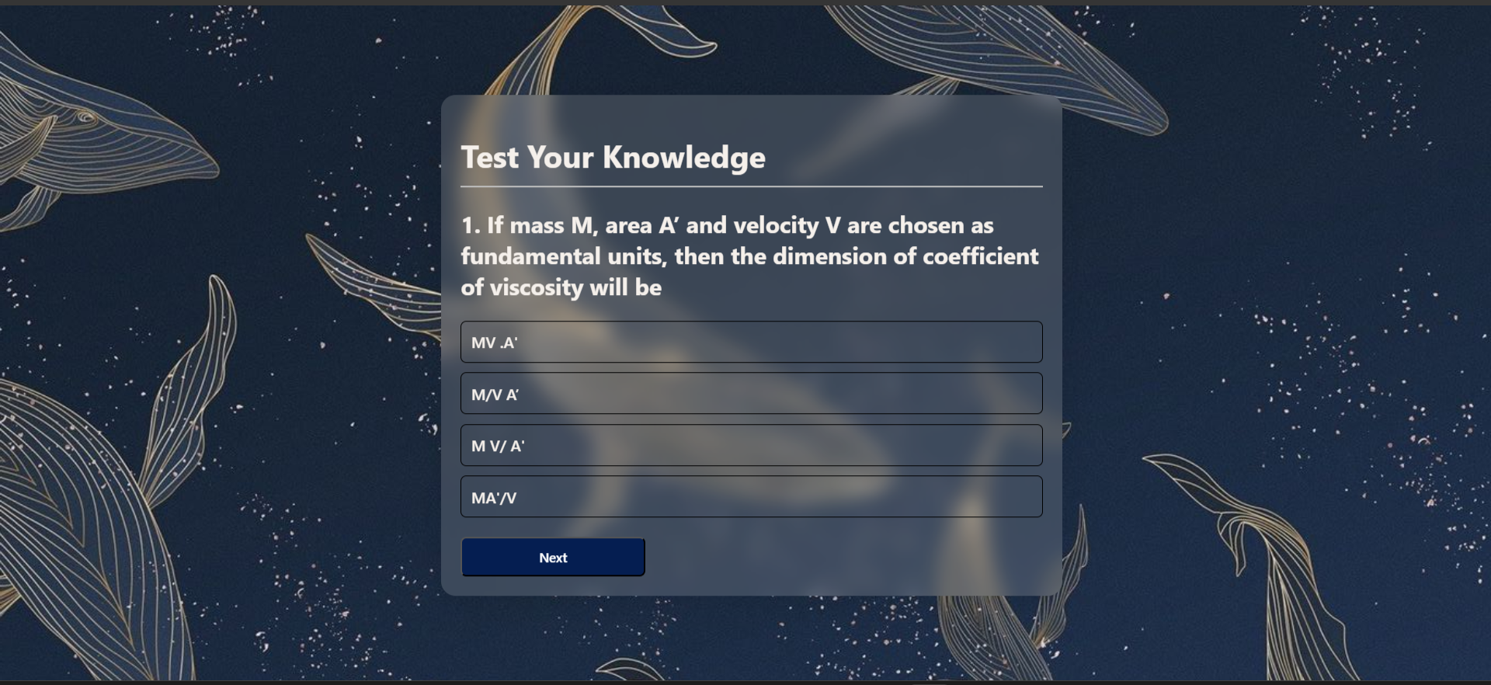

Slide 17
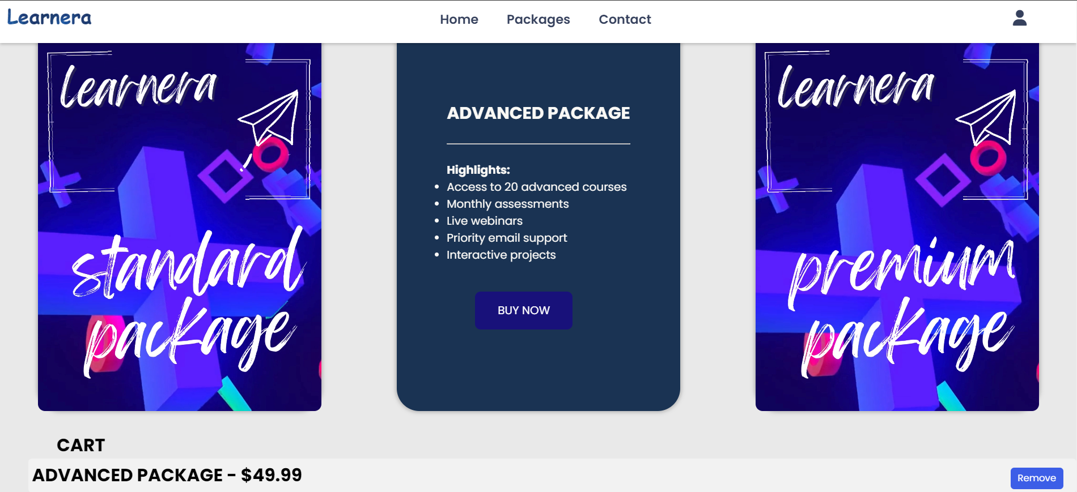

Slide 18
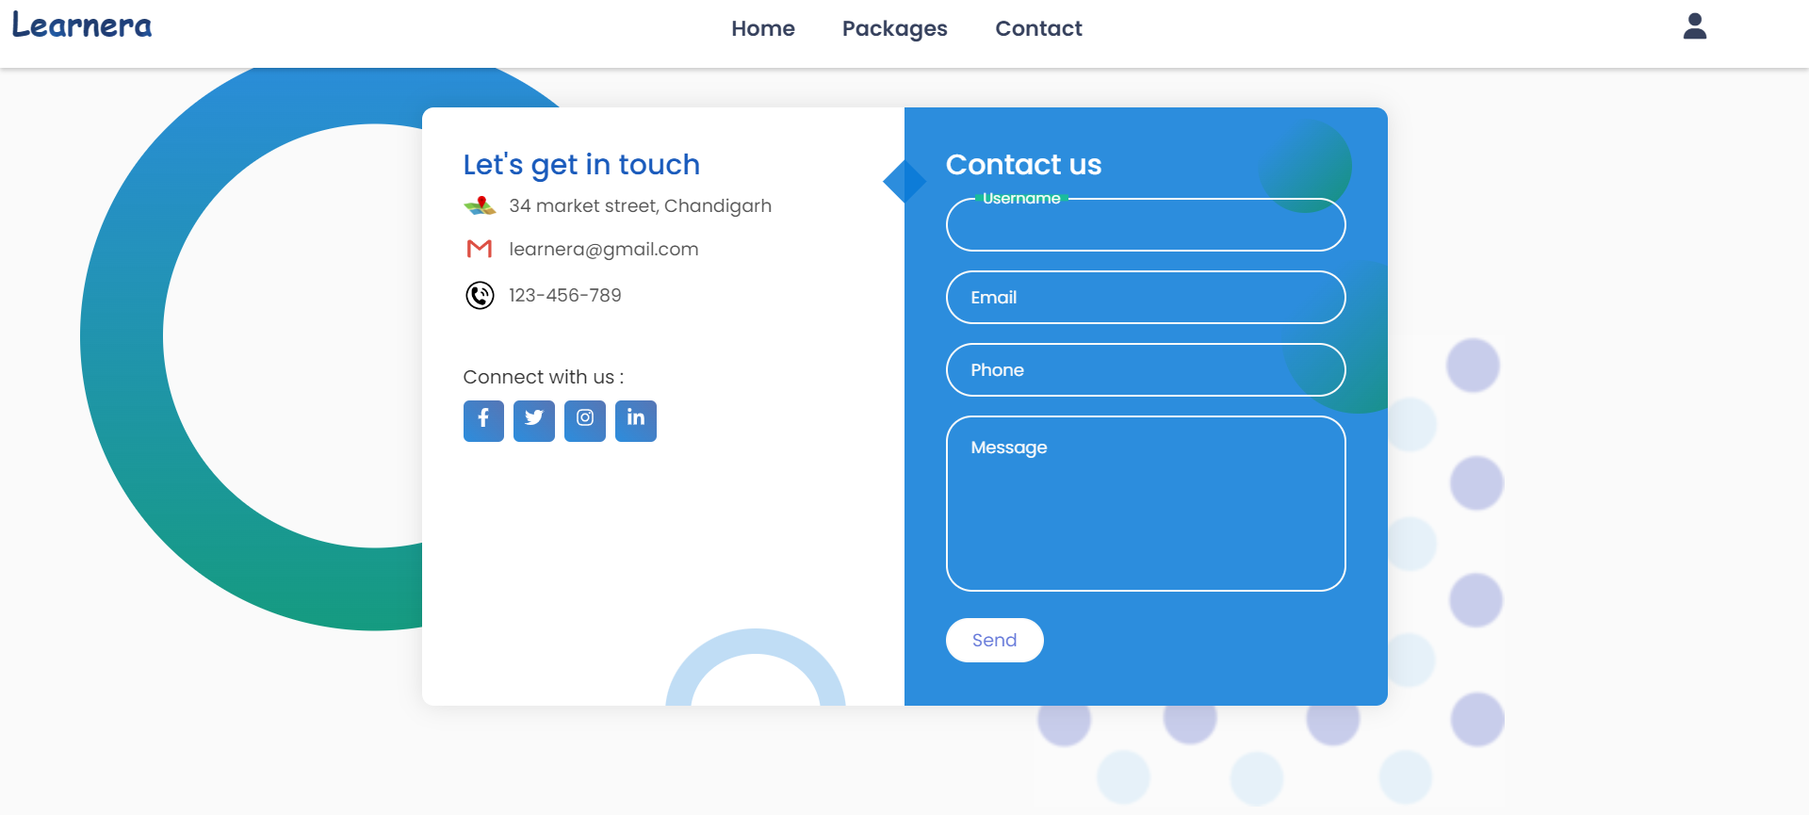

Slide 19
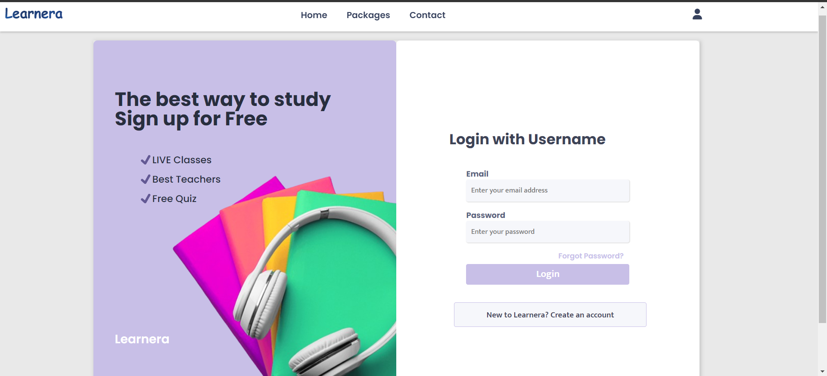

Slide 20

RESULT
The website utilizes HTML, CSS, and JavaScript to create an interactive and engaging user experience.
Modern design with intuitive navigation.
Prominent carousel slider for visuals.
Offers quizzes for knowledge testing.
Dynamic image changes for results.
FAQ section for common queries.
Footer includes essential link

Slide 21

CONCLUSION
In conclusion, the development of our educational website demonstrates the power of modern web technologies in creating an engaging and interactive online platform
Through intuitive navigation, visually appealing design elements, and dynamic content presentation, this website aims to provide a seamless learning journey for users of all ages.
Features such as quizzes, testimonials, and teacher showcases enhance user engagement and foster a sense of community within the platform.

Slide 22

REFERENCE
W3Schools. (n.d.). React Tutorial. Retrieved from https://www.w3schools.com/react.js/
JavaScript.info. (n.d.). Introduction to JavaScript. Retrieved from https://javascript.info/intro
Canva. (n.d.). Create Beautiful Designs with Canva. Retrieved from https://www.canva.com
YouTube –Codeevolution channel
Vedauntu:online educational website. Retrieved from https://www.vedantu.com
Freepik : for getting the icons. Retrieved from https://www.freeepik.com

Slide 23
The End

